Slide 1
Low cost wastewater treatment

Slide 2
Septic tank
It is a primary horizontal continuous flow type of sedimentation tank having extra provision to digestion of settled sludge
Properties.
Detention time- 12 to 36 hr
It removes 60% to 70% of dissolve matters.
Cleaning period-6 month to 3 years
Tank Functions
Solids removal by settling & floatation
60-80% solids removal
Anaerobic digestion
Storage of solids
Factors that Influence Anaerobic Digestion
pH
Temperature
Chemicals
Highly variable flow patterns
Pharmaceuticals and personal care products (PPCPs)
Process wastewaters
Lack of tank maintenance

Slide 3
Diagram of septic tank

Slide 4
Septic tank
Element of Septic Tank

Slide 5
Cross Section of Tank

Slide 6
Anaerobic Digestion
CO2
CH4
H2S
NH3
Role of the septic tank
➢Anaerobic fermentation of solids
➢Reduce the load of pathogens in the effluent
➢Hold the effluent for 2-3 days for improved safety
➢Retain solid material to prevent blockage of further disposal system
Effluent
Subsurface irrigation, Cess pool, Soak pit or trickling filter

Slide 7
Merits and demerits of Septic Tank
Advantage
It can be easily constructed.
No maintenance problem.
It excellently remove BOD.
Very less amount of solids are produced.
Low cost
Disadvantage
Its size should be very large to serve many people.
Smell problem
It needs periodic
cleaning.

Slide 8
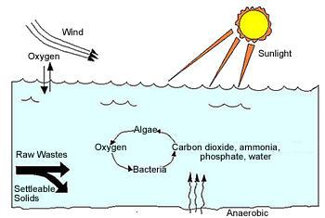
Oxidation pond/ Waste Stabilization Ponds
a body of wastewater employed with the retention of wastewater or organic wastes until the wastes are rendered stable and inoffensive for discharge into stream through physical, chemical and biological processes involving the action of algae and bacteria under the influence of sunlight and air
1.6 mg of oxygen is released by the algae/mg of dry organic cell material synthesized
Optimum temperature 30 to 35ºC

Slide 10
SEWER APPURTENANCES
for proper functioning and to facilitate maintenance of the sewage system,
various additional structures have to be constructed on the sewer lines. These structures are sewer appurtenances.
Manholes
Inlets
Catch basins
Flushing devices
Regulators
Inverted siphons
Grease and oil traps
Lamp holes
Leaping weirs
Junction chambers

Slide 11
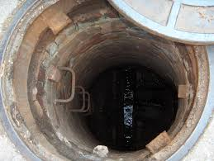
Manholes
R.C.C or masonry chambers constructed on the sewer line to facilitate a man to enter the sewer line and make the necessary inspection and repairs
fitted with suitable cast iron covers
change in direction, change in pipe size, or considerable change in gradient
minimum size is 50cm diameter.
Classification - Depth
  Shallow Manhole 0.75 -0.9 m
  Normal Manhole – 0.9 – 1.5 m
  Deep Manhole > 1.5 m

Slide 12
Types of Manhole
  Shallow Manhole
  At Start of branch sewer
  Inspection Chamber
Normal Manhole
Rectangular/Square
0.8m X 1.2 m/1m X 1m
Section not changed with depth
Heavy cover at the top
  Deep Manhole
  Larger at bottom
  Reduced at top
  By providing offset
  Steps to access
  Heavy cover at the top

Slide 13
Deep Manhole C/S

Slide 14
Drop Manhole
It is a measure of connecting high level branch sewer to low level main sewer.
through a vertical pipe.
difference in level > 60cm between branch & main sewer,
avoids increasing the sewer grade

Slide 15
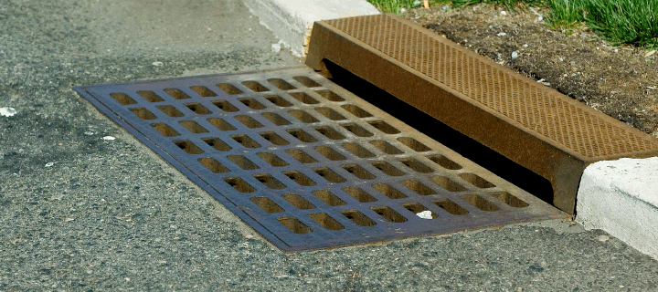
Catch Basins
structures of pucca chamber and a stout cover for the retention of suspended grit, sludge and other heavy debris and floating rubbish from rain water which otherwise cause choking problems
Submerged outlet pipe( Sewer Pipe)
use is not recommended
more of a nuisance
source of mosquito breeding
substantial maintenance problems.

Slide 16
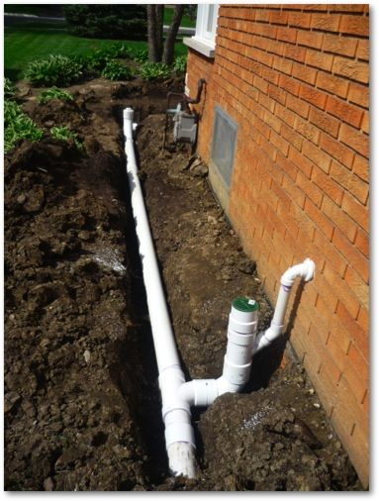
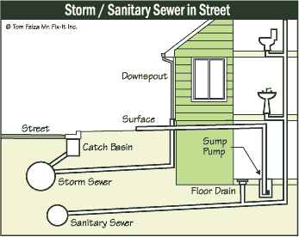

Slide 17
Basic principles of good drainage system
Material have adequate strength and durability.
Diameter of drain to be as small as possible.
Accessibility- every part of drain within reach for inspection and maintenance.
Laid in straight runs as far as possible.
Drains laid to a gradient.
Inlet be trapped. To prevent entry of foul air into building.
Access fittings - Inspection chamber, rodding eye, manhole - placed at changes of direction and gradient.
Inspection chambers placed at junctions.
Junctions between drains arranged so that incoming drain joints at oblique angle in direction of flow.
Avoid drain under buildings if possible.

Slide 18
Typical layout plan showing house drainage connections

Slide 19
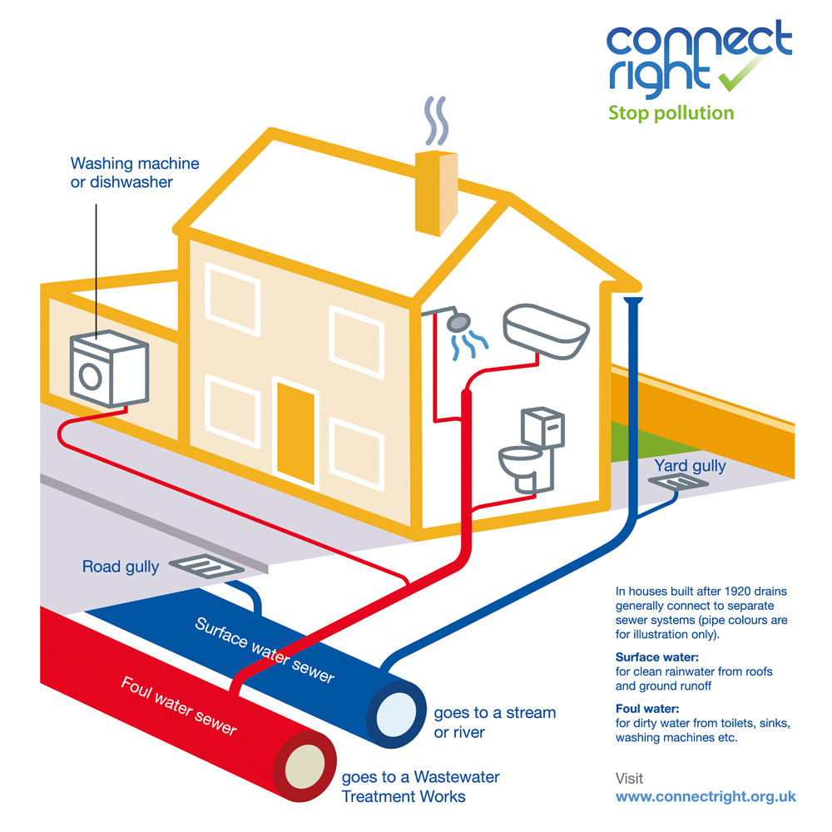

Slide 20
Maintenance of house drainage
For efficient working - should be properly maintained and cleaned at regular intervals.
1. Entry of undesired elements - should take extreme precautions to avoid entry of undesired elements - grit, sand, decayed fruits, pieces of cloths, leaves, etc.
2. Flushing - advisable to flush system once or twice in a day to maintain it in proper working order.
3. Inspection - should be inspected at regular intervals and the obstructions if any should be removed. Damaged pipes should also be replaced.
4. Quality of materials - Better quality materials should be used

Slide 21
Materials of sewer
(i) Asbestos cement sewers
(ii) Bricks sewers
(iii) Cast iron sewers
(iv) Cement concrete plain or reinforced
(v) Corrugated iron sewers
(vi) Stoneware sewers
(vii) Steel sewers
(viii) Plastic sewers
(ix) Wooden sewers

Slide 22
Asbestos Cement Sewers
mixture of asbestos fibers, silica and cement. Asbestos fibers act as reinforcement
size 10 to 100 cm dia and L= 4.0 m.
easily assembled -special coupling, called ‗Ring Tie Coupling‘ or Simplex joint
resistant to corrosion , joints are flexible to permit 12º deflection
Advantage
light in weight , Easy to cut, Interior is smooth – Highly efficient
Disadvantages
not very strong, susceptible to corrosion
Bricks sewers:
made at site
are replaced by concrete sewers
large size combined sewer or particularly for storm water drains
pipes are plastered from outside to avoid entry of tree roots and ground water
lined from inside with stone ware or ceramic block
  smooth and hydraulically efficient
  make the pipe resistant to corrosion

Slide 23
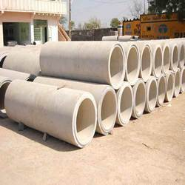
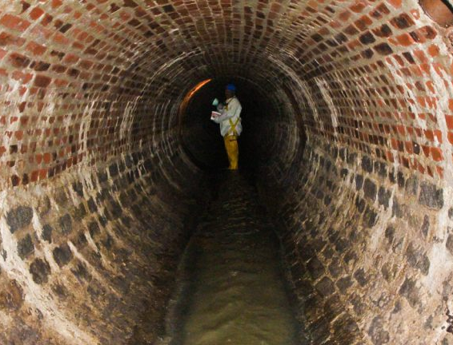
Bricks sewers:
Asbestos Cement Sewers

Slide 24
Cast Iron Sewers
stronger and capable to withstand greater tensile, compressive, as well as bending stresses
used for where pipes are running under pressure outfall sewers, rising mains of pumping stations, and inverted siphons,
heavy traffic load, such as sewers below railways and highways
100% leak proof inside with cement concrete, coal tar paint, epoxy, etc.
Advantage
less resistant to corrosion
Disadvantages
Costly
Plain Cement Concrete or RCC : 1: 1.5: 3 -
PC- 0.45 m diameter RCC -1.8m dia,
cast in situ or precast pipes
reinforcement 0.25% ,
single cage - internal pressure < 0.8 m
double cage - internal pressure >0.8 m
  elliptical cage - larger dia to external pressure;
smooth and hydraulically efficient
  make the pipe resistant to corrosion
Advantage
  Tension, Compression,. Easily molded, economical
Disadvantage
  Corrode, carrying capacity, susceptible to erosion

Slide 25
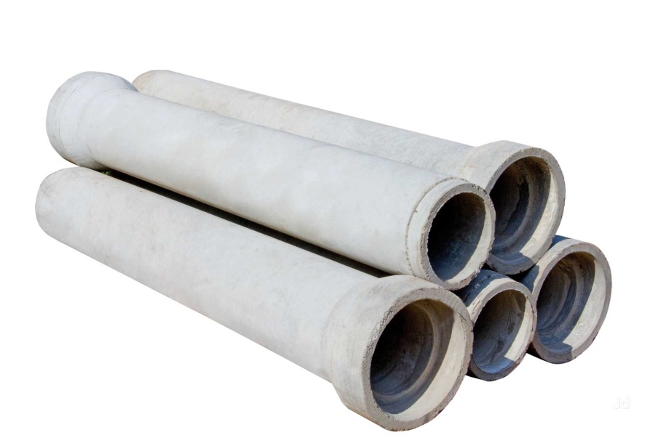
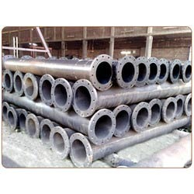
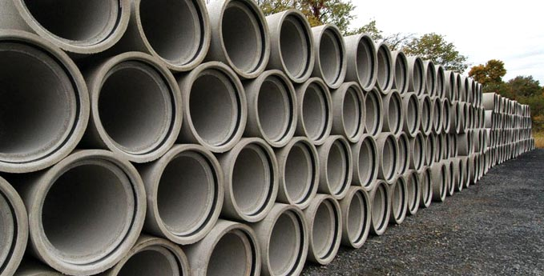
Plain Cement Concrete or RCC
Cast Iron Sewers

Slide 26
Corrugated iron sewers:
galvanization or by bituminous coatings
Dia upto 450cm.
Plastic sewers PVC
internal drainage works in house
sizes 75 to 315 mm external diameter
smooth internal surface
resistant to corrosion, light weight of pipe, economical in laying, jointing and maintenance
tough and rigid
High Density Polythylene (HDPE) Pipes
not brittle ,resistant damage
joined by welding or with detachable joints up to 630 mm smooth internal surface
conveyance of industrial wastewater

Slide 27
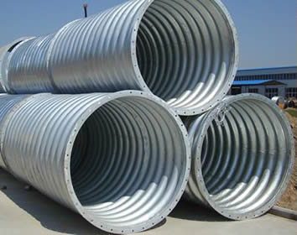
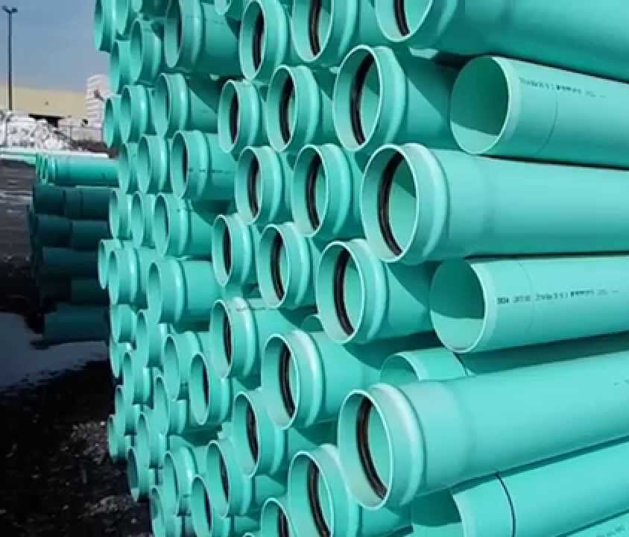
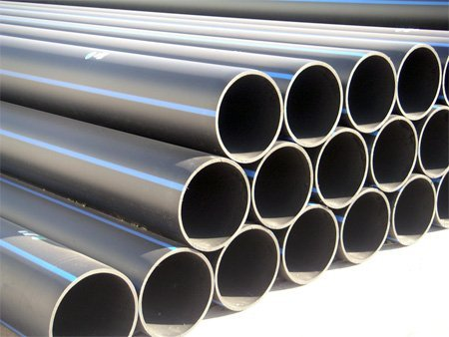
Corrugated iron sewers
Plastic sewers PVC
High Density Polythylene (HDPE) Pipes

Slide 28
Steel sewers
  lightness, imperviousness and resistance to high pressure
  trunk or outfall sewers
  situations such as pressure main sewers, under water crossing, bridge crossing, necessary connections for pumping stations, laying pipes over self supporting spans, railway crossings, etc.
  Pressure better than CI pipes
  Disadvantage
  cannot withstand high external load
  susceptible to corrosion and are not generally used for partially flowing sewers
Vitrified Clay or Stoneware Sewers
used for house connections as well as lateral sewers
5 cm to 30 cm internal dia with L 0.9 to 1.2 m
Advantages
Resistant to corrosion , Interior surface is smooth, Strong in compression.
does not absorb water more than 5% of their own weight, when immersed in water for 24 h
Disadvantage
Heavy, bulky and brittle and weak in tension

Slide 29
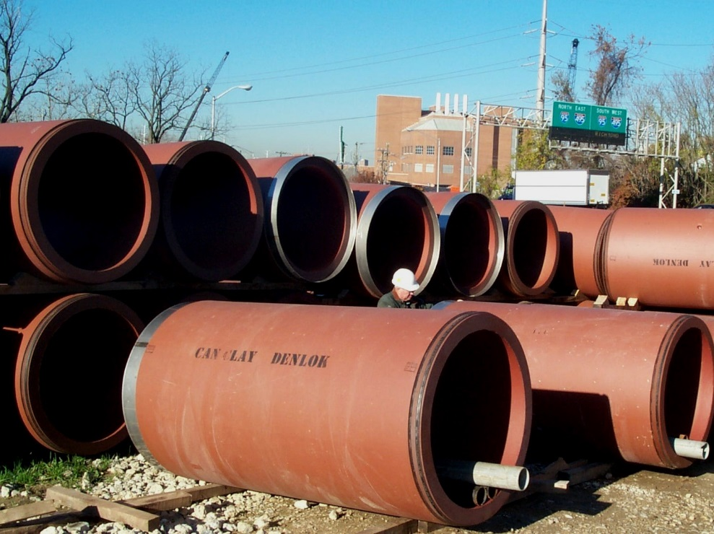
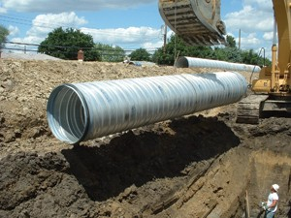
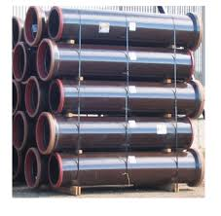
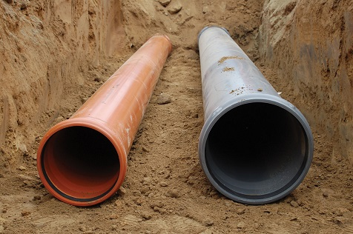
Vitrified Clay or Stoneware Sewers
Steel sewers

Slide 30
Shapes of Sewers
generally circular pipes - below ground level, slopping - towards the outfall
designed to flow under gravity
other than circular are also used
a. Standard Egg-shaped sewer
b. New egg-shaped sewer
c. Horse shoe shaped sewer
d. Parabolic shaped sewer
e. Semi-elliptical section
f. Rectangular shape section
g. U-shaped section
h. Semi-circular shaped sewer
i. Basket handled shape sewer

Slide 31
got better hydraulic properties,
it is costly
longer perimeter more material for construction
odd shape it is difficult to construct
Rarely used in India
suitable in care of combined sewers

Slide 32
semi-circular with sides inclined or vertical
bottom may be flat, circular or paraboloid .
large sewers with heavy discharged
tunnels, trunk sewer
upper arch takes the shape of parabola
invert of the sewer may be flat, parabolic or elliptical .
used for the disposal of relatively small quantities of sewage

Slide 33
gives a wider care at the bottom
suitable for constructing large sewers with less available headroom
replaced by rectangular sewers.
more suitable for soft soils as they are more stable
not suitable for carrying low discharges
Dia > 180 cm.

Slide 34
Trench provided at the bottom is called cunnette
easy to construct
invert may be flat or semi-circular
sides are generally vertical and top may be flat or arched
resembles the shape of a basket handle
Small discharges flow - bottom narrower portion.
combined sewage flows in the full section.

Slide 35
Laying of sewers
SURVEY LINE AND GRADE
The CONTRACTOR shall set Temporary Bench Marks (TBM'S) at a maximum 500 foot interval
check line and grade of the pipe by laser beam method
If line and grade do not meet specified limits, the WORK shall be stopped, remedial measures
PIPE PREPARATION AND HANDLING
All pipe and fittings shall be inspected prior to lowering into trench to insure no cracked, broken
shall clean ends of pipe thoroughly and remove foreign matter and dirt from inside of pipe and keep clean during and after laying
Pipe shall be properly lowered to avoid any physical damage to the pipe. not be dropped or dumped into trenches

Slide 36
SEWER PIPE LAYING
Laying to line and grade in the trench only after dewatered
Mud, silt, gravel and other foreign material shall be kept out of the pipe
All pipe laid shall be retained in position until sufficient backfill has been completed to adequately hold the pipe in place
Variance < “one-thirty second of an inch / inch of pipe” diameter and not to exceed one-half (½) inch
The sewer pipe shall be installed with the bell end forward or upgrade.
When pipe laying is not in progress the open end of the pipe shall be
kept tightly closed with an approved temporary plug.

Slide 37
Testing of sewer line
Types of Sewer Tests
Sewer Testing for Leakage (Water Test) :
Smoke test
Sewer Testing for Straightness of Alignment and Obstruction
Sewer Testing for Leakage (Water Test)
To ensure no leakage through the joints after joints to set in
tested from manhole to manhole under test pressure of 1.5m of water head ( depth of water in the manhole is maintained at about 1.5m.)
lower end of the sewer is plugged
water is then filled in the manhole at the upper end and allowed to flow through the sewer line.
watched by moving along the trench
the joints which leak or sweat are repaired, leakage pipe will be replaced

Slide 38
Sewer Testing for Straightness of Alignment and Obstruction (Test for straightness and obstruction)
Tested by placing a mirror at one end of the sewer line and a lamp at the other end.
If the pipe line is straight, the full circle of light will be observed
if the pipe line is non-straight, this would be apparent and the mirror will also indicate any obstruction in the pipe barrel.
Any obstruction
inserting at the upper end - a smooth ball of dia 13mm < internal diameter of sewer pipe
yarn or mortar through the joints etc. the ball shall roll down the invert of the sewer pipe and emerge at the lower end

Slide 39
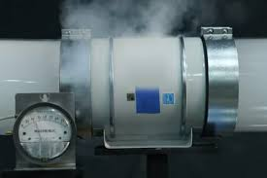
Smoke test
This test is performed for soil pipes, vent pipes laid above ground.
Conducted under a pressure of 2.5 m of water and maintained for 15 minutes after all trap real have been filled with water.
The smoke is produced by burning oil waste or tar paper in combustion chamber of a smoke machine.

Slide 40
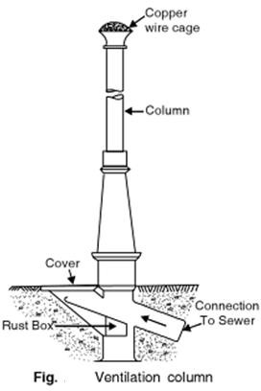
Ventilation of Sewer
organic and inorganic matters - decompose and produce gases
cause air locks in sewers and affect the flow of sewage, dangerous for the maintenance squad working in
Methods of Ventilation
Laying sewer line at proper gradient.
Running the sewer at half full or 2/3 depth.
Providing manhole with gratings.
Proper house drainage.
Providing the ventilating columns or shafts.

Slide 41
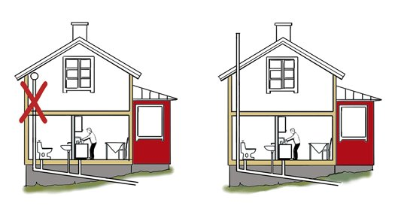
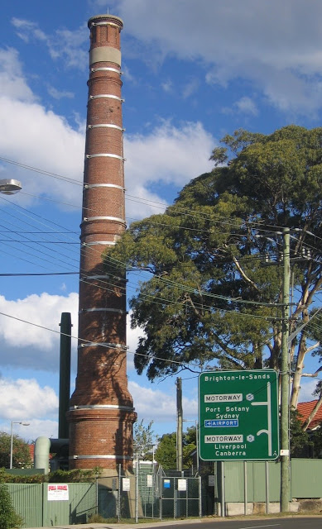
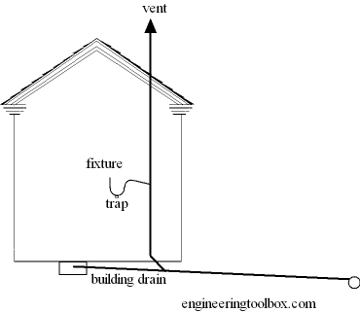
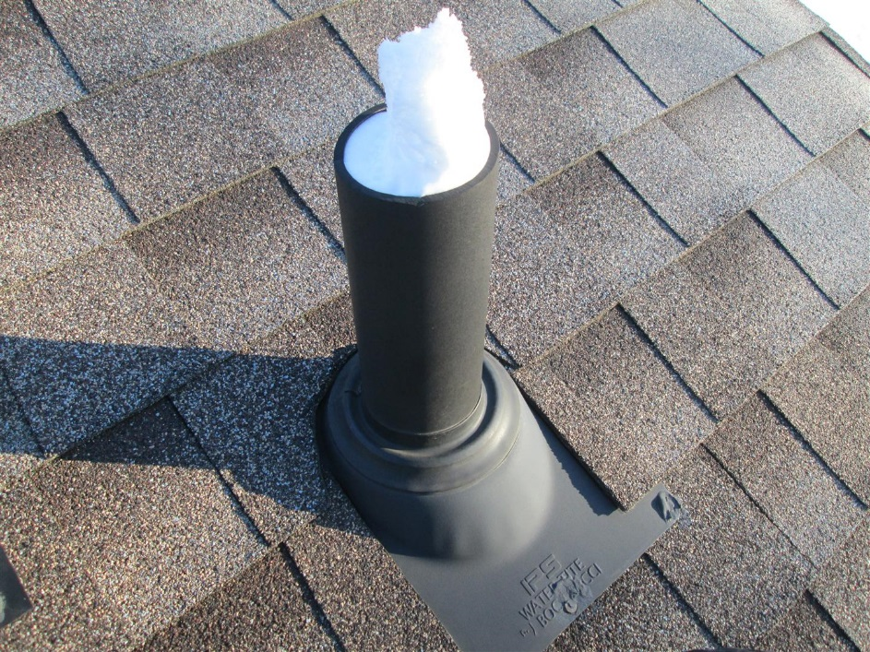

Slide 42
DISPOSAL OF EFFLUENTS

Slide 43
SELF PURIFICATION
The automatic purification of natural water is known as self purification. The self purification of natural water systems is a complex process that often involves physical, chemical, and biological processes working simultaneously
Dilution: When sufficient dilution water is available in the receiving water body
Current: When strong water current is available, the discharged wastewater will be thoroughly mixed with stream water preventing deposition of solids
Temperature: The quantity of DO available in stream water is more in cold temperature than in hot temperature.
Sunlight: sunlight helps in purification of stream by adding oxygen through photosynthesis.
Rate of Oxidation: The rate of oxidation of organic matter depends on the chemical composition of organic matter.

Slide 44
CONDITIONS FAVOURABLE FOR DILUTION
Where sewage is fresh.
Where favorable currents exits in a stream.
Where sewage is almost free from floating/ Settleable solids.
Where thorough mixing is possible.
Where diluting water has high quantities of dissolved oxygen.
When the city is situated near river or sea.

Slide 45
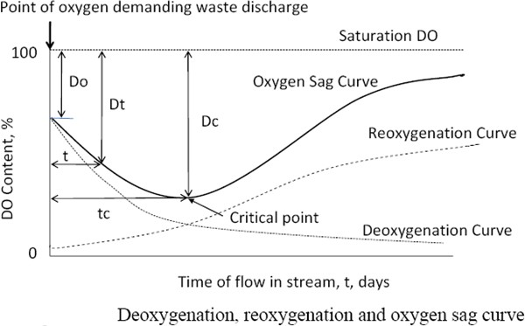
Oxygen Sag Curve
deficit in the stream at any point of time during self purification process is the difference between the saturation DO content and actual DO content at that time.
Oxygen deficit, D = Saturation DO – Actual DO
de - oxygenation + re -oxygenation curves. = oxygen sag curve

Slide 46
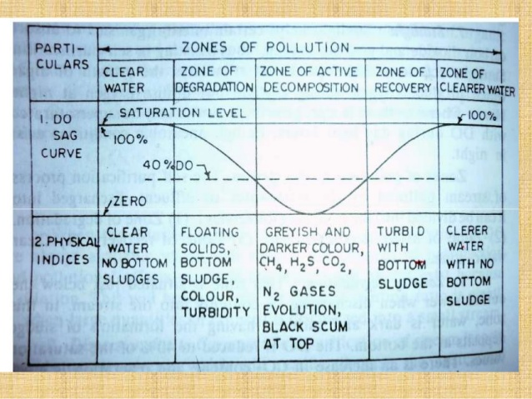
Zones of purification

Slide 47
Mathematical analysis of Oxygen Sag Curve:
Streeter – Phelps equation
or
Where,
K= K¹ = BOD reaction rate constant, to the base 10
  R = R¹= Re Oxygenation constant to the base 10
  Do = Initial oxygen deficit at the point of waste discharge at time t = o
  t = time of travel in the stream from the point of discharge = x/u
  x = distance along the stream
  u = stream velocity

Slide 48
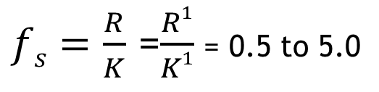
Determination of Critical DO deficit (D_{c}) and distance X_{c}
or
or
K¹=K/2.303
R¹=R/2.303
Where, = 1.056 in general
= 1.047 for 20oC to 30ºC
= 1.135 for 4oC to 20ºC
$fs=\frac{R}{K}$ =$\frac{R1}{K1}$ = 0.5 to 5.0

Slide 49
METHOD OF LAND TREATMENT
SEWAGE FARMING
Process in which sewage is used for growing crops
fertilizing elements of sewage – NPK used by the roots of crops
nutrients of sewage make the fields fertile
APPLICATION OF SEWAGE METHODS
Flooding method
Surface irrigation method
Zig zag method
Lagooning method
Basin method
Sub-soil irrigation method
RIDGE AND FERROW IRRIGATION METHOD

Slide 50
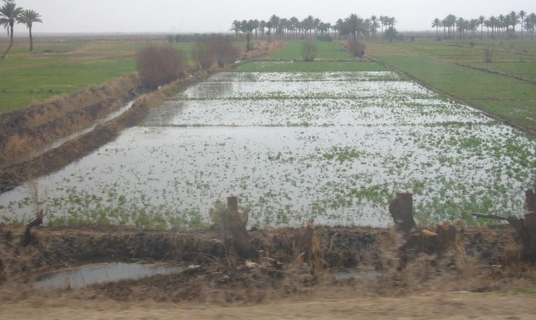
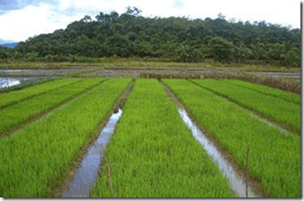
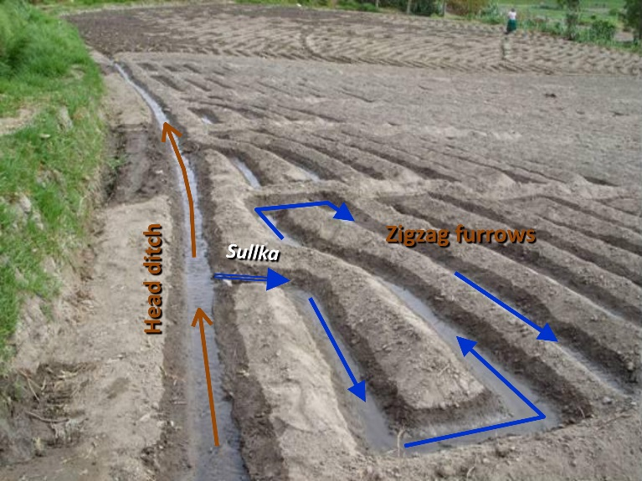
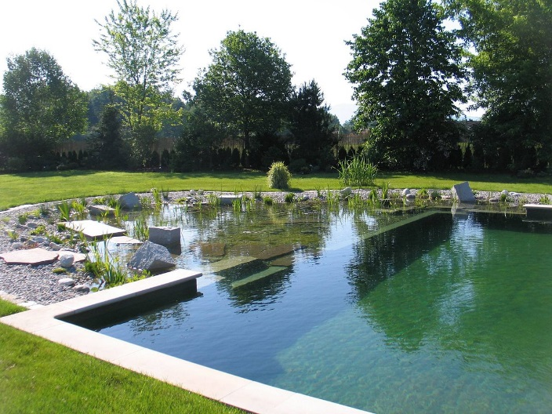
FLOODING METHOD –
divided into various parts surrounded by dykes.
sewage is filled like small ponds in between the dykes
Depth = 3.0 - 5.0 cm
SURFACE IRRIGATION
suited in sloping area
parallel drains are constructed in fields
drains are connected to a distributaries drain with regulating device
large quantity is absorbed by the field and only excess quantity reaches another drain.
ZIG ZAG METHOD -ridges are arranged in a zag-zag method
LAGOONING
natural depression available
Detention period = 1 month
sludge is stabilized and dried
shallow and must be constructed away from town

Slide 51
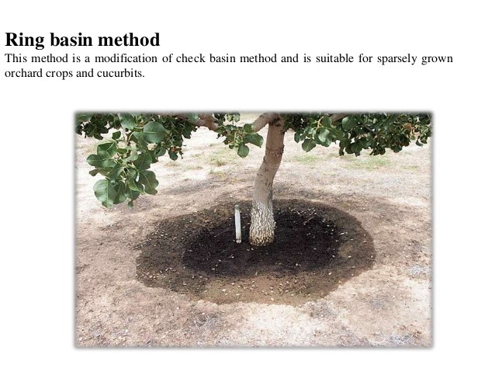
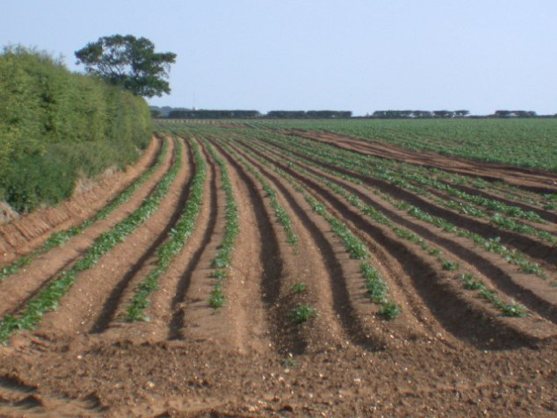
SUB SURFACE IRRIGATION
sewage applied at the roofs of plants, through the open jointed drain-pipes
pipes are laid at 1.0 m below the GL
BASIN METHOD:
big trees are planted in an isolated manner,
basins are formed around each tree and filled with sewage.
suitable for fruit gardens
RIDGE AND FERROW IRRIGATION
Ridge
Width=125-250 cm Length 10-30 m.
Furrow
Width = 120-150 cm Depth 25-50 cm
percolated effluent is collected in underground drains flows towards natural drainage for disposal

Slide 52
FAVOURABLE CONDITIONS FOR SUB-SURFACE IRRIGATION
Subsoil water level is low.
Land is cheap.
Rainfall is less and irrigation water demand is heavy.
Large areas are available.
Where dilution water is not easily available.
Sub-surface strata is porous, favoring infiltration.
Climate is dry favoring drying up conditions.

Slide 53
SEWAGE SICKNESS
soil getting clogged and loses its capacity of receiving the sewage load when the sewage is applied continuously on a piece of land is called sewage sickness
PREVENTION OF SEWAGE SICKNESS:-
Primary treatment like screening & sedimentation should be given to sewage before its application to land so that suspended solids are removed & the pores of soil will not be clogged.
The sewage should be applied intermittently on land i.e by giving rest to the land for sometime .The land should be ploughed during non supply period of sewage so that soil gets aerated.
Keeping some portion of land reserved in order to use the same in resting period .Enough area will be required for this purpose.
By planting different crops on the same land by rotation system of crops .The soil will be aerated & will utilise the fertilizing elements of sewage.
By providing sufficient under drainage system to collect the excessive sewage quantity.
By frequent ploughing & rotation of soil.
By not applying the sewage in excess quantity.

Slide 54
Sewage Farming

Slide 55
Characteristics of Wastewater

Slide 56
Physical Characteristics
Colour
greyish brown or yellowish, - fresh sewage.
stale and septic sewage - black
( Zero DO - becomes septic).
Odour
fresh sewage is considered as odorless, but as it starts to get stale, it begins to give
offensive odor.
Within 3 to 4 hours, all oxygen present in the sewage
gets exhausted and it starts emitting offensive odour by hydrogen sulphide gas which is formed due to anaerobic decomposition of sewage.

Slide 57
Colour

Slide 58
Temperature
biological activity
solubility of gases in sewage
viscosity of sewage
temperature, of sewage > temperature of the water
average temperature of sewage in India is about 20⁰ C - ideal temperature of sewage for
biological activities
Turbidity
Turbid-dirty dish water or wastewater from baths fecal matter, pieces of paper, cigarette ends, match sticks, greases, vegetable debris, fruit skins, soaps, etc
depends on the quantity of solid matter present in suspension state

Slide 59
Turbidity

Slide 60
Chemical Characteristics
Helps in indicating the stage of sewage decomposition, its strength, and extent and
type of treatment required for making it safe the chemical characteristics of sewage
includes.

Slide 61
Solids
Sewage -99.9 % water and only 0.1 %
suspended solids, dissolved solids, colloidal solids, and Settleable solids.
about 1000 kg of sewage contains
0.454 kg - TS
0.225 kg - solution,
0.112 kg - suspension and
0.112 kg - settle able.
can be organic or inorganic
45 organic % & 55 % inorganic
Inorganic matter - minerals & salts - sand, gravel, dissolved salts, chlorides, Sulphates, etc.

Slide 62
Organic matter
Organic matter
Carbohydrates like cellulose, cotton, starch, sugar, etc..
Fats and oils
Nitrogenous
protein and their decomposed product, including wastes from animals,
urea, fatty acids etc.
inorganic solids in sewage is not harmful

Slide 63
Soilds
Total Solids (S1 in mg/ lit)
Suspended Solids (S 2 )
Dissolved Solids and colloidal (S3 )
Volatile and Fixed Suspended Solids

Slide 64
Solids

Slide 65
pH
pH can be determined using pH meter ( Potentiometer)
pH tends to fall due to production of acid by bacterial action in anaerobic or nitrification processes.
Especially the biological treatment, for better result the pH of sewage should be around 7.0 in biological treatment as microorganisms

Slide 67
Nitrogen Content
(Nitrogen Compounds)
The presence of nitrogen in sewage is an indication of the presence of the organic matter and may occur in one or more of the following forms:
• Free ammonia called ammonia nitrogen
• Albuminoid or Organic Nitrogen
• Nitrites
• Nitrates

Slide 68
The free ammonia indicates the very first stage of decomposition of organic matter ( thus indicating recent pollution);
Albuminoidal nitrogen - the quantity of nitrogen in sewage before the decomposition of organic matter.
Nitrates - presence of fully oxidized organic matter in sewage.
The nitrites - intermediate stage of conversion - indicating the progress of treatment. sewage treatment is incomplete, and sewage is stale.
nitrates - well oxidized and treated sewage.
Nitrites are dangerous, Nitrates is not dangerous.
Higher nitrates - adversely the health of infants - mathemoglobinemia blue baby disease
vomit; their skin colour may become dark and may die in extreme case

Slide 69
Mathemoglobinemia

Slide 70
Chlorides Contents
kitchen wastes, human feces and urinary discharges
normal - 120 mg/lit, P Limit - 250 mg /lit.
Source : ice cream plants, meat salting etc..
Indicates : Industrial wastes or infiltration of seawater, thereby indicating strength of sewage
standard silver nitrate solution

Slide 71
Fats, Oils and Greases
from the discharge of animals and vegetable matter, or from the garages, kitchens of hotels and restaurants, etc..
form scum on the top of the sedimentation tanks, clogs the voids of the filter media and affects the diffusion of oxygen.
Toxic
Copper, lead, silver, chromium, arsenic, phenols, boron, cyanides, etc.. are some of the
Affect microorganisms resulting in malfunctioning from industrial waste.

Slide 72
Sulphides, Sulphates and Hydrogen Gas
decomposition of various sulphur containing substances in Sewage
evolution of hydrogen sulphide gas, bad odours, - corrosion sewer pipes.
In aerobic digestion of sewage,
  Sulphur --→ sulphides, -→ sulphates ions In an-aerobic digestion
In an-aerobic digestion
sulphates --→ sulphides, -H2S gas along with methane and carbon dioxide

Slide 73
Sulphides, Sulphates and Hydrogen Gas

Slide 74
Dissolved Oxygen
Dissolved oxygen is the amount of oxygen in the dissolved state in the wastewater.
at least 4 mg/l of DO is present in it
aquatic animals like fish etc. are likely to be killed near the vicinity of disposal

Slide 75
Biochemical Oxygen Demand
There are two types of organic matter
• (i) Biodegradable or biologically active
• (ii) Non biodegradable or biologically inactive
• Organic matter is often assessed in terms of oxygen required to complete oxidize the organic matter to CO2, H2O, and other end products of Oxidation.
• Biochemical Oxygen Demand (BOD) is defined as the amount of oxygen required by the microorganisms (mostly bacteria) to carry out decomposition of biodegradable organic matter under aerobic conditions.
Carbonaceous matter - biodegradable carbonaceous material – Heterotrphic bacteria
Nitrogenous matter - nitrogenous matter -autotrophic bacteria

Slide 76
5 days period is generally chosen for the standard BOD test, during which oxidation is about 60 to 70 % complete, while within 20 days period oxidation is about 95 % to 99 % complete.
A constant temperature of 20⁰ C is maintained during incubation. The BOD value of 5 Day incubation period is commonly written as BOD 5 or simply as BOD.
Another reason to avoid interference of nitrification bacteria (starts after 6th or 7th day)

Slide 79
BOD Curve

Slide 80
Limitation of BOD Test
It measures only the biodegradable organic matter.
Time duration of the test is very long i.e. 5 days, so if quick results are needed it is not useful.
Pretreatment is needed if the sample contains toxic waste.
Nitrifying bacteria can cause interferences and could give higher results. To avoid them proper care must be taken.
It is essential, to have high concentration of active bacteria present in the sample.

Slide 81
Chemical Oxygen Demand
COD can be defined as amount of oxygen required to chemically oxidize organic matter using a strong oxidizing agent like potassium dichromate under acidic condition.
COD test, takes 3 hours in comparison to 5 days for BOD test
In COD test, a strong chemical oxidizing agent like potassium dichromate is used in acidic medium to oxidize the organic matter present in the waste
Almost all type of organic matter with a few exceptions can be oxidized by the action of strong oxidizing agents under acidic conditions.
Total Organic Carbon
Theoretical Oxygen Demand

Slide 82
Biological Characteristics
microorganisms like bacteria, algae, fungi, protozoa, etc. bacteria being the most predominant. Most of the bacteria found in the sewage are harmless non-pathogenic bacteria.
at the time of outbreak of epidemics, certain tests may be done to find the type of pathogens

Slide 84
SAMPLING TECHNIQUES
1. Grab or catch samples:
A sample collected at a particular time and place → composition of the source at that times and place Source fairly constant in composition over a considerable period of time / substantial distances in all direction, In such circumstances same source may be quite well represented by single grab samples.
2. Composite samples:
composite refers to a mixture of grab samples collected at the same sampling point at different time.
most useful for observing average concentrations - alternative to the separate analysis of a large number of samples,
3. Integrated samples:
Mixture of grab samples collected from different points simultaneously or as nearly as possible
for river or stream that varies in composition across its width and depth.

Slide 85
Flow diagram of Municipal waste water treatment plant

Slide 86
Conventional wastewater treatment processes
consists of a combination of physical, chemical and biological processes and operations to remove solids, organic matter and sometimes, nutrients from wastewater.
General terms used to describe different degrees of treatment, in order of increasing treatment level, are preliminary, primary, secondary, and tertiary and/or advanced wastewater treatment.
In some countries, disinfection to remove pathogens sometimes follows the last treatment step

Slide 87
Conventional wastewater treatment process

Slide 88
Conventional wastewater treatment process
Preliminary treatment
The objective is the removal of coarse solids and other large materials often found in raw wastewater, operations typically include coarse screening, grit removal and, in some cases, comminution of large objects
Primary treatment
The objective is the removal of settle-able organic and inorganic solids by sedimentation, and the removal of materials that will float (scum) by skimming

Slide 89
Secondary treatment
The objective of secondary treatment is the further treatment of the effluent from primary treatment to remove the residual organics and suspended solids
  Aerobic biological treatment is performed in the presence of oxygen by aerobic microorganisms (principally bacteria) that metabolize the organic matter in the wastewater, thereby producing more microorganisms and inorganic end-products (principally CO2, NH3, and H2O)
  Several aerobic biological processes are used for secondary treatment differing primarily in the manner in which oxygen is supplied to the microorganisms and in the rate at which organisms metabolize the organic matter

Slide 90
screens
Bigger pieces of wood, plastic, metal, rubber, textile - bar screens
bars - spaced about 1/2-3/4 inches apart.
Manually cleaned bar screens
operator must rake the collected debris from a manually cleaned bar screen.
45-degree angle.
Automatically cleaned bar screens
set of rakes - chain-driven. units - operate periodically
60º and 90º an automatically cleaned
Screenings - hauled to a landfill for disposal.

Slide 91
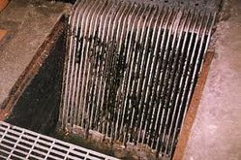
screens
Automatically cleaned bar screens
Manually cleaned bar screens

Slide 92
corrosion problems with steel screens
Hydrogen sulfide - attack the metal bars.
Repair and replacement of the bars
weekly inspections - rake teeth and the chain drive.
Two types of bar screens:
Coarse sieves -greater than 6 mm
fine sieve - smaller than 6 mm

Slide 93
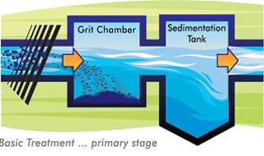
grit chambers
Grit chambers are nothing but like sedimentation tanks, designed to separate the intended heavier inorganic materials (specific gravity about 2.65) and to pass forward the lighter organic materials

Slide 94
Detritus tank
similar to a grit chamber. The difference being only in the velocity of flow and the detention period
appreciable amount of organic matter settles down along matter by blowing the compressed air through the detritus tanks
2.5 to 3.5 m length and detention period 3 to 4 minutes
V = 20cm/sec to 40cm/sec.

Slide 95
Oil and Grease removal
Grease in sewage include fats, waxes, free fatty solids, calcium and magnesium soaps, mineral oils, etc.,
restaurants, kitchens, garages, soap and candle factories, oil refineries, slaughter houses etc.,.
foul odour may be developed at the surface, scum retards reoxygenation and thus causes anaerobic condition
do not digest easily, in sludge digestion tanks
    promote clogging of the trickling filters.
affect the biological activities of the organisms
by floatation or settling as scum or sludge.

Slide 96
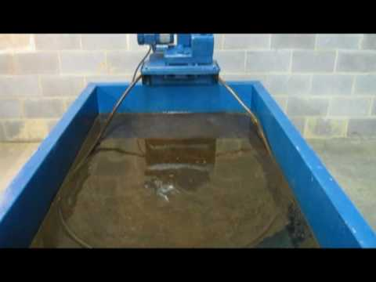
skimming tanks
narrow rectangular tanks having at least two longitudinal baffle walls, interconnected
Air diffusers are provided at the bottom 300 to 6000 m³ per million litres of sewage agitates the sewage
Air tends to change the oil and grease to a soapy mixture
mixture is carried to the surface by the air bubbles, some of which are entrained in it and may be skimmed off.

Slide 97
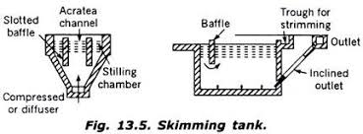

Slide 98
Equalization
Basins are designed to provide consistent influent flow to downstream processes by retaining high flow fluctuations.
Due to the additional retention time, aeration and mixing is required in to prevent the raw wastewater from becoming septic and to maintain solids in suspension.
Objective –
Decrease fluctuations in flow rate, to provide more consistent treatment
Accomplished by storing excess wastewater during high flow periods
Excess wastewater is released during low flow periods

Slide 99
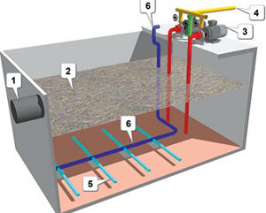
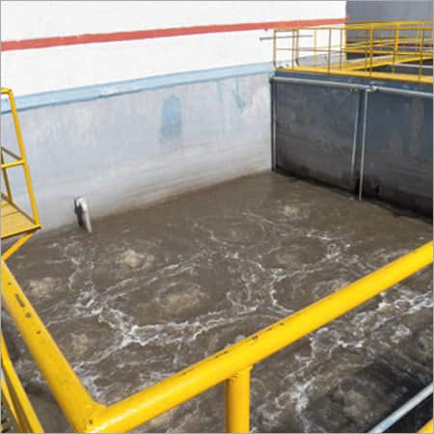
Equalization Tank

Slide 101
Secondary Treatment

Slide 102
Attached Growth Process
In this process micro organisms are responsible for conversion of organic matter present in waste water to gases and cell tissues are attached to some inert medium such as rock, slag, ceramic or plastic material.
This process include:
  1.Intermittent sand filters
  2.Trickling filters
  3.Rotating biological contactors
  4.Packed bed reactors
  5.Anaerobic lagoons.
  6.Fixed film denitrification.

Slide 103
Suspended Growth Process
In this process micro organisms are responsible for conversion of organic matter present in waste water to gases and cell tissues are maintained in suspension within the liquid in the reactor by employing either natural or mechanical mixing.
This process include:
  Activated sludge process.
  Aerated lagoons.
  Sludge digestion system.
  Suspended growth nitrification & denitrification

Slide 104
Combined Process
This process includes both attached growth and suspended growth process.
This process include :
1.Trickling filter, activated sludge.
2.Activated sludge, trickling filter.
3.Faculative lagoons

Slide 105
Trickling Filters
It consists of a basin or tower filled with support media such as stones, plastic shapes, or wooden slats
Wastewater is applied intermittently, or sometimes continuously, over the media
Microorganisms become attached to the media and form a biological layer or fixed film
Organic matter in the wastewater diffuses into the film, where it is metabolized

Slide 106
Trickling Filters
Oxygen is normally supplied to the film by the natural flow of air either up or down through the media, depending on the relative temperatures of the wastewater and ambient air
The thickness of the biofilm increases as new organisms grow, Periodically, portions of the film slough off the media
The sloughed material is separated from the liquid in a secondary clarifier and discharged to sludge processing
Clarified liquid from the secondary clarifier is the secondary effluent and a portion is often recycled to the biofilter to improve hydraulic distribution of the wastewater over the filter

Slide 107
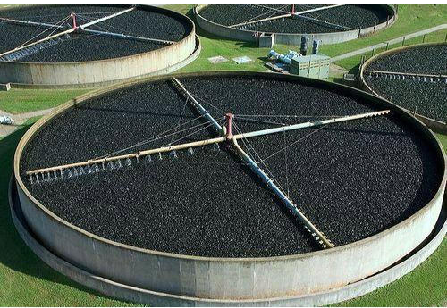
Mechanism
microorganisms - attached to an inert packing material rock, gravel, slag, sand, redwood, and a wide range of plastic and other synthetic materials.
bed of highly permeable media on whose surface a mixed population of microorganisms is developed as a slime layer.
Passage of wastewater - a gelatinous coating of bacteria, protozoa and other organisms on the media
distribution system, media, under drains, effluent channel, secondary settling tank, and recirculation pumps and piping.

Slide 109
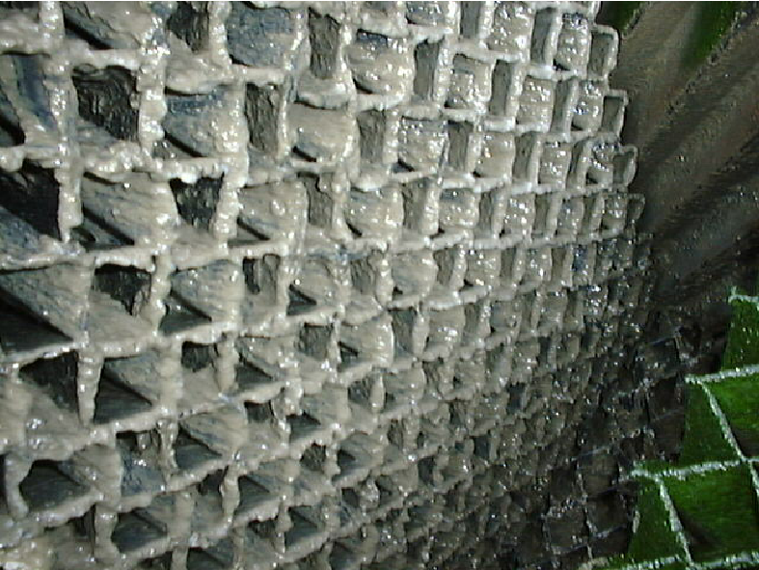
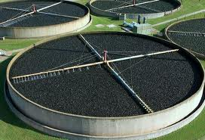

Slide 111
Common Problems
Ponding
cause odors and decrease filter efficiency.
Cause
excessive organic loading without high R,
Use of small media.
Clogging of UGD,
Non-uniform media size / breaking up of media,
Trash or debris in filter voids
Remedies
Spraying the surface with high pressure water hose.
Stirring or agitating ponding area with stick, rake, etc.
Dosing the filter with chlorine
Flooding filter and keeping the media submerged for approximately 24 hours

Slide 112
Filter Flies
Cause
tiny, gnat-size flies are called psychoda.
Remedies
Increasing recirculation
Flushing the side walls of the filter by opening the flap valve
Flooding the filter intermittently
addition of Cl, - toxic to the flies and larvae.
Odors.
Cause
anaerobic conditions
Remedies
maintain aerobic condition
Check the ventilation
Check the UGD clogging and stoppages
Increase R;
odor-masking agents
Pre-chlorination at primary tank

Slide 113
Conventional filters are modified high rate filters
  Better quality filtering media is used, like larger size stone media or plastic media.
  Depth of media is limited to 1.5 to 2m
  Size of UGD is increased and their slope made steeper so that the filter effluent can be collected and conveyed quickly.
  Speed of rotating arm is increased.
  Size of SST increased.

Slide 114
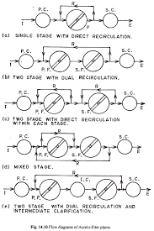
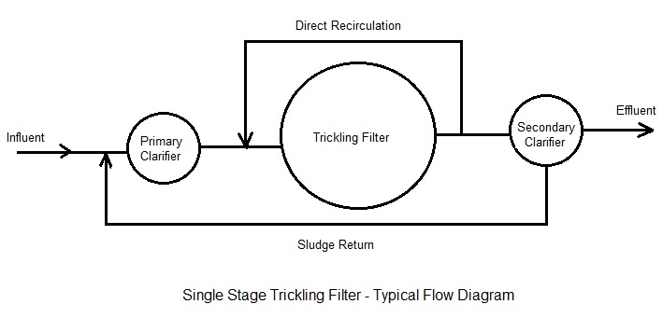

Slide 115
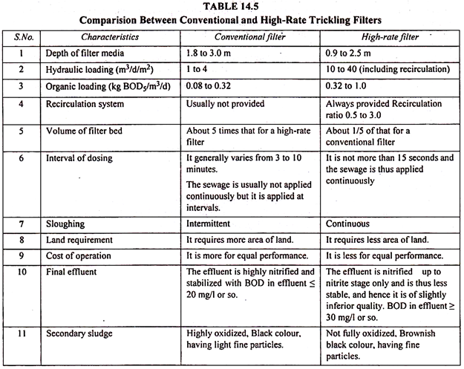

Slide 116
Activated Sludge Process
In the activated sludge process, the dispersed-growth reactor is an aeration tank or basin containing a suspension of the wastewater and microorganisms, the mixed liquor
The contents of the aeration tank are mixed vigorously by aeration devices which also supply oxygen to the biological suspension
Aeration devices commonly used include submerged diffusers that release compressed air and mechanical surface aerators that introduce air by agitating the liquid surface
HRT in the aeration tanks - 3 to 8 hours but can be higher with high BOD₅

Slide 117
Activated Sludge
Following the aeration step, the microorganisms are separated from the liquid by sedimentation and the clarified liquid is secondary effluent
A portion of the biological sludge is recycled to the aeration basin to maintain a high mixed-liquor suspended solids (MLSS) level
The remainder is removed from the process and sent to sludge processing to maintain a relatively constant concentration of microorganisms in the system

Slide 118
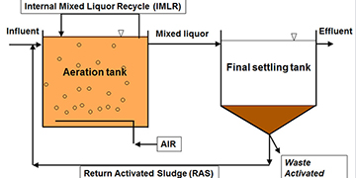

Slide 120
Sequencing batch reactor (SBR)
In a conventional activated sludge system, unit processes would be accomplished by using separate tanks.
Sequencing batch reactor is a modification of activated sludge process which has been successfully used to treat municipal and industrial wastewater.
The difference between the two technologies is that the SBR performs equalization, biological treatment, and secondary clarification in a single tank using a timed control sequence.

Slide 121
Reasons for providing SBR
where there is a limited amount of space is available.
Older treatment facilities can be retrofitted to an SBR (because the basins are already present).
SBR Operating Principles
SBR technology is a method of wastewater treatment in which all phases of the treatment process occur sequentially within the same tank.
The sequencing batch reactor is a fill and draw activated sludge system. In this system, wastewater is added to a single “batch” reactor, treated to remove undesirable components, and then discharged.

Slide 122
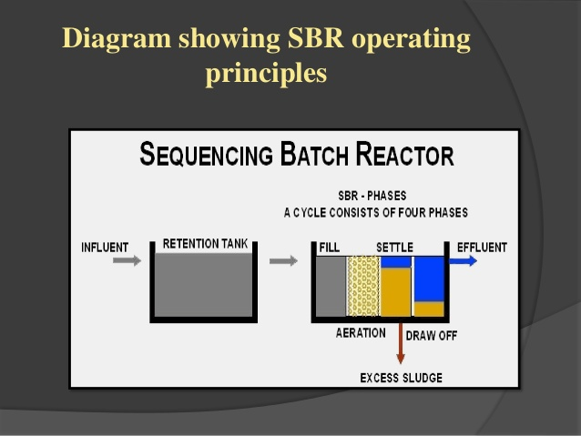

Slide 123
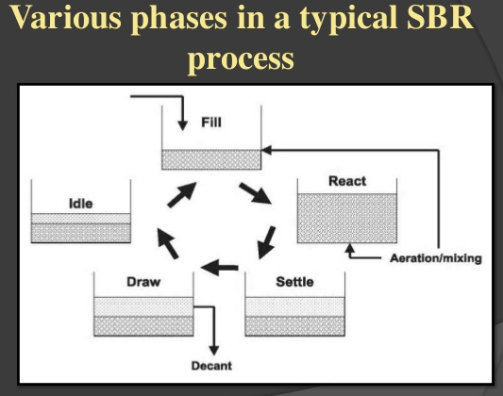

Slide 124
Fill Phase
During the fill phase, the basin receives influent wastewater. The influent brings food to the microbes in the activated sludge, creating an environment for biochemical reactions to take place.
Types of fill phase
  Static fill
  Mixed fill
  Aerated fill
React Phase
During this phase, no wastewater enters the basin and the mechanical mixing and
aeration units are on.

Slide 125
Settle Phase
During this phase, activated sludge is allowed to settle under quiescent condition . The activated sludge tends to settle as a flocculent mass.
Decant Phase
Clarified treated effluent (supernatant) is removed from the tank. No surface foam or scum is decanted.
Idle Phase
This step occurs between the decant and the fill phases.
The idle period is used when the system is waiting for enough effluent to process.

Slide 126
Advantages of SBR
Equalization, primary clarification, biological treatment and secondary clarification can be achieved in a single reactor vessel.
SBR requires small space.
SBR has controllable react time and quiescent settling.
Minimal footprint.
High nutrient removal capabilities.
The BOD removal efficiency is generally 85 to 90%
Filamentous growth elimination

Slide 127
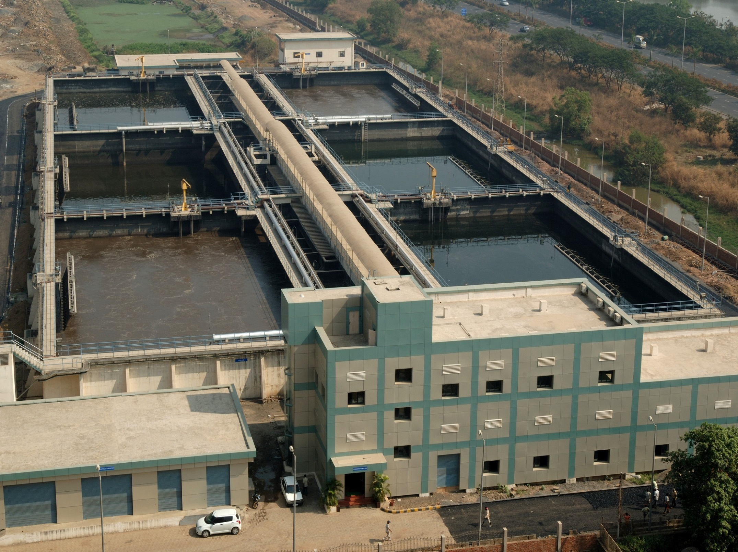

Slide 128
Limitations of SBR
A higher level of sophistication is required especially for larger systems, of timing units and controls.
Higher level of maintenance associated with more sophisticated controls, automated switches, and automated valves.
Potential plugging of aeration devices during selected operating cycles, depending on the aeration system used by the manufacturer.

Slide 129
MBBR (Moving bed biofilm reactor)
Small cylindrical shaped polyethylene carrier added in aerated or non aerated basin to support biofilm growth.
Biomass grows primarily on protected surface on the inside of the carriers.
Air agitation or mixers are used to continuously circulate carriers. Perforated plates at the outlet of the tanks keeps biofilm carrier inside the tank.
MBBR can be a single reactor or configured as several reactors-in-series.

Slide 130
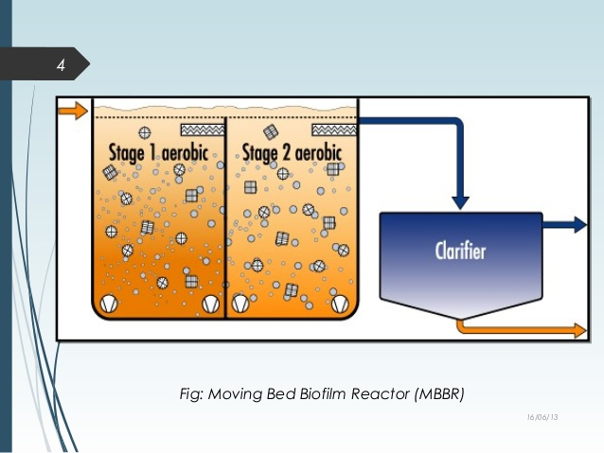

Slide 131


Slide 132


Slide 133
Advantages:
High-efficiency CBOD removal and nitrification(even in low temperature environments)
Retention of slow-growing and temperature-sensitive bacterial populations (i.e., autotrophic nitrifiers and methanol-degrading heterotrophs, respectively) low HRT
Reduced sludge production compared with activated sludge
No problems with odours, snails or red-worms as in air phase fixed films

Slide 134
Advantages:
Smaller foot prints.
MBBR Provides Five times the Biofilm Surface Area in less than ¼ Reactor Volume as Trickling Filter
Can be operated at varying influent load
Can be easily retrofitted.

Slide 135

Sludge Digester

Slide 136
Hydrolysis
transforms suspended organic matter into soluble organics.
polymeric compounds ---→ monomeric or dimeric compounds.
optimal pH 6
Acidogenesis
soluble organics -→ volatile fatty acids, mostly C2-C4 acids.
volatile fatty acids lowers the pH
pH < 4, the production of acids
Acetogenesis
the VFA, ethanol + Water ---→ acetic acid, CO₂ and H₂.
Methanogenesis
70% of acetic acid, CO₂ and H₂ --→ methane
30% of the biogas is produced in the hydrogenotrophic methanogenesis

Slide 137

RCC or steel tank of cylindrical shape with hopper bottom and is covered with fixed or floating type of roofs

Slide 138
Factors affecting process of Sludge Digestion
Temperature
thermophilic zone 40-60⁰C and mesophilic zone- 25 to 40⁰C
pH value
Seeding
  Seeding with the digested sludge encourage the growth of useful bacteria
Mixing and stirring of raw sludge with digested sludge:
  mixed with raw sludge for optimum conditions for the growth and activities of bacteria.

